Slide 1
DoD 8140 Townhall
Hosted by:
Department of War Chief Information Officer Workforce Innovation Directorate
DoW CIO | June 5, 2026

Slide 2




DoD 8140 Townhall
Agenda & Opening Remarks
DCWF & DoD 8140 Update
Cyber Workforce Data & Analytics Update
Cyber Workforce Governance Update
Closing Administrative Announcements
DoW Component Open Forum

Slide 3
DCWF Work Role Alignment to Workforce Elements
Current as of 28 January 2026
(NEW) DCWF Work Role
Effective January 2026
CYBER IT
OPR: DoW CIO
CYBERSECURITY
OPR: DoW CIO
CYBER EFFECTS
OPR: ASW(CP)/DoW PCA
INTEL (CYBER)
OPR: USW (I&S)
DATA / AI
OPR: DoW CDAO
SOFTWARE ENG
OPR: USW R&E
(411) Technical Support Specialist
(421) Database Administrator
(431) Knowledge Manager (KM)
(441) Network Operations (NETOPS) Specialist
(451) System Administrator (SYSADMIN)
(452) Secure Configuration Specialist
(632) Systems Developer
(641) Systems Requirements Planner
(651) Enterprise Architect (ENTARCH)
(661) Research and Development (R&D) Specialist
(671) System Testing and Evaluation (T&E) Specialist
(212) Cyber Defense Forensics Analyst
(462) Control Systems Security Specialist
(511) Cyber Defense Analyst
(521) Cyber Defense Infrastructure Support Specialist
(531) Cyber Defense Incident Responder
(541) Vulnerability Assessment Analyst
(611) Authorizing Official (AO)/Designated Rep.
(612) Security Control Assessor
(622) Secure Software Assessor
(631) Information Systems Security Developer
(633) System Security Engineer
(652) Security Architect
(722) Information Systems Security Manager (ISSM)
(723) Communications Security (COMSEC) Manager
(121) Exploitation Analyst
(122) Digital Network Exploitation Analyst (DNEA)
(131) Joint Targeting Analyst (JTA)
(132) Target Digital Network Analyst (TDNA)
(133) Target Analyst Reporter (TAR)
(321) Access Network Operator
(322) Cyberspace Operator
(332) Cyber Operations Planner
(341) Cyberspace Capability Developer (CCD)
(442) Network Technician
(443) Network Analyst
(463) Host Analyst
(551) Red Team Specialist
(111) All-Source Analyst
(151) Multi-Disciplined Language Analyst
(311) All-Source Collection Manager
(312) All-Source Collection Requirements Manager
(331) Cyber Intelligence Planner
(422) Data Analyst
(423) Data Scientist
(424) Data Steward
(623) Artificial Intelligence / Machine Learning (AI/ML) Specialist
(624) Data Operations Specialist
(653) Data Architect
(672) AI Test & Evaluation Specialist
(733) AI Risk & Ethics Specialist
(753) AI Adoption Specialist
(902) AI Innovation Leader
(903) Data Officer
(461) Systems Security Analyst
(621) Software Developer
(625) Product Designer User Interface (UI)
(626) Service Designer User Experience (UX)
(627) Development, Security, Operations (DevSecOps) Specialist
(628) Software/Cloud Architect
(673) Software Test & Evaluation Specialist
(806) Product Manager
CYBER ENABLERS OPR: DoW CIO
Leadership: (732) Privacy Compliance Manager; (751) Cyber Workforce Developer and Manager;
(752) Cyber Policy and Strategy Planner; (901) Executive Cyber Leader
Legal: (211) Forensics Analyst; (221) Cyber Crime Investigator; (731) Cyber Legal Advisor
Trng & Educ: (711) Cyber Instructional Curriculum Developer; (712) Cyber Instructor
Acquisition: (801) Program Manager; (802) IT Project Manager; (803) Product Support Manager;
(804) IT Investment/Portfolio Manager; (805) IT Program Auditor

Slide 4
DCWF Status & Way Ahead
CURRENT VERSION: 5.1
Includes updates to (IT-451) System Administrator and the addition of (CE-551) Red Team Specialist
(CS) Information Systems Security Officer
(CS) Information Systems Security Manager
(CS) COMSEC Manager
(CE) Data Engineer
(CE) Analytic Support Officer
WORK ROLES UNDER REVIEW
To include two new work roles:
(IT-452) Secure Configuration Specialist
(CS-633) System Security Engineer
To include one new universal core knowledge statement for all work roles:
“Knowledge of Zero Trust Security Model Principles”
VERSION: 5.2
Anticipated Publication: June 2026

Slide 5

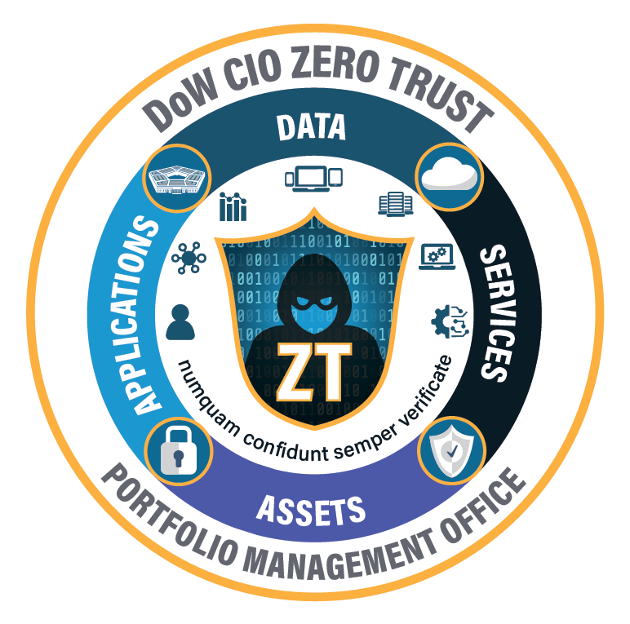
Zero Trust Training Plan – 2026 and Beyond
5 June 2026 DoD 8140 Townhall
Contact: Rick Phillips DoW CIO Zero Trust PfMO richard.b.phillips50.ctr@mail.mil

Slide 6
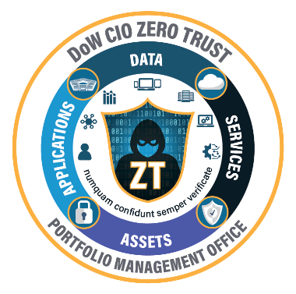

DoW Zero Trust Training: Suspense:
30 September 2027
Overview
Zero Trust was officially confirmed as a universal Knowledge, Skill, and Ability (KSA) at the January 2026 Cyber Workforce Management Board meeting to help modernize the DoW cyber workforce.
Driven by Executive Order 14028 and constant, sophisticated cyberthreats, the ZT PfMO is leading the enterprise strategy to ensure all DoW Components implement Zero Trust by FY27.
To support this critical transition and meet implementation goals, Zero Trust training is available to DoW personnel on WarU using a CAC or PIV card.

Slide 7




Zero Trust Levels
Basic
Intermediate
Advanced
Continuous Learning
Have familiarity with basic concepts and processes and the ability to apply these with frequent, specific guidance.
JKO Zero Trust Awareness US003 (1 hour/1 Continuous Learning Point (CLP)
JKO Zero Trust for Executives US005 (1 hour/1 (CLP)
JKO Zero Trust for Strategy and Guidance US006 (1 hour/1 (CLP)
Have competent knowledge of basic concepts and processes and experience applying these with only periodic high-level guidance.
Basic Level Course
JKO Zero Trust for Implementation US007 (level 2/1 hour/1 CLP)
Applies expert knowledge to navigate and resolve complex, ambiguous challenges independently. Ability to excel in unstructured environments by applying ZT adoption.
Intermediate Level Course
WarU Two-day ZT Practitioner’s Workshop (16 CLPs/monthly)
Minimum of 20 hours annually or what is required to maintain certification; whichever is greater.
Microsoft E5 Training (for MS Environment Users)
Zero Trust Virtual Learning Exchange (24 CLPs)
ZT for OT Workshops (semi-annual/summer 2026 TBD)
Commercial
Certificate of Competence in Zero Trust (CCZT) Intermediate/ Advanced - 16 hours
SEC 530 - Defensible Security Architecture & Engineering – Advanced – 44 hours.
ZT Strategy: Embed ZT training across DoW Components, related workforce requirements, and certification standards …

Slide 8
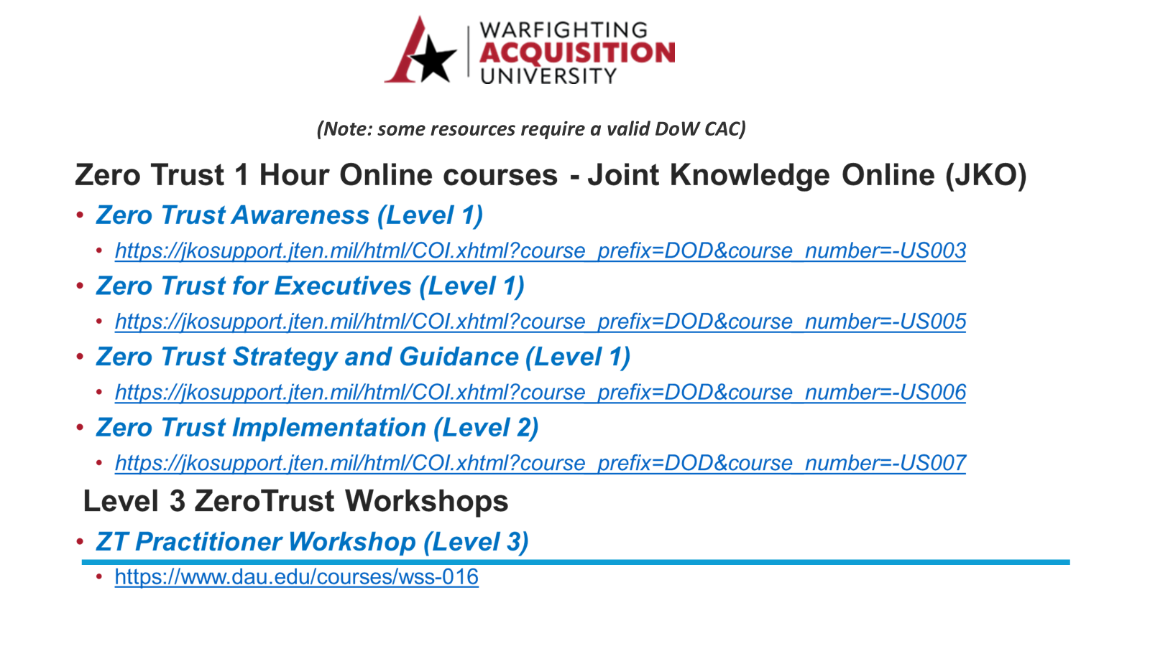

Slide 9
DoD 8140 Proficiency Level Alignment Update
DCWF (EN-901) Executive Cyber Leader
DCWF WORK ROLE 901 EXECUTIVE CYBER LEADER
Definition: Executes decision-making authorities and establishes vision and direction for an organization's cyber and cyber-related policies, resources, and/or operations, while maintaining responsibility for risk-related decisions affecting mission success.
NEW AUTHORITATIVE GUIDANCE
The DCWF (EN-901) ECL work role applies to DoW civilians at a federal civil service pay grade of GS-15 (or equivalent) under special circumstances with command-level decision making authorities that do not have GO/FO/SES staff on hand. It is not recommended that this work role be an option for GS-15 personnel universally.
The DCWF (EN-901) ECL work role also applies to military service officers at the O-6 pay grade or above, and DoW Senior Executive Service (SES) personnel (or equivalent).
The DCWF (EN-901) ECL work role does not apply to contract support personnel.
The DoD 8140 advanced proficiency level is the only proficiency level that applies to this work role. The basic and intermediate proficiency levels do not apply to this work role.
This guidance will be reflected in the DCWF work role tool, as a footnote in this work role’s description, and in the DCWF Identification and Coding Guidance.

Slide 10

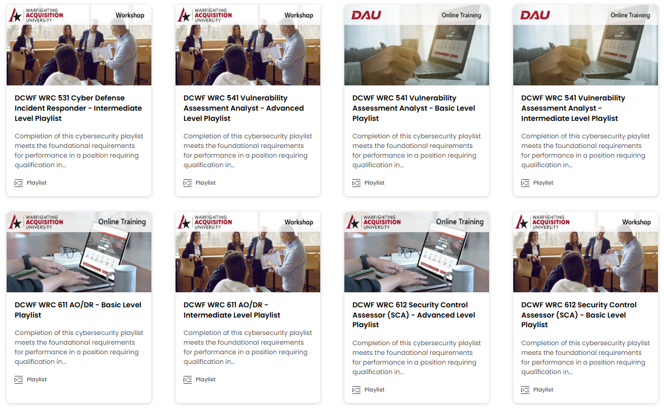
DoD 8140 Qualification Update
Warfighting Acquisition University
MORE THAN A NAME CHANGE
Warfighting Acquisition University (WarU) is taking bold, calculated risks to accelerate the delivery of critical capabilities. Together, we can drive change.
ACHIEVING OVERMATCH:
Warfighting Acquisition University (WarU) is an accredited, government-owned, DoD 8140 foundational qualification provider
Provides 71 learning playlists to satisfy DoD 8140 foundational qualification for DCWF CS, IT, EN 800 series work roles at all three proficiency levels, aligning to 100% of core KSATs of a given work role, when practicable
Provides a free cyber range to support DCWF work role mastery
Provides virtual, asynchronous training to accelerate student qualification
FUTURE FORECAST:
Updates to WarU domain name and DoD 8140 credentials
Credential completion certificate in development to streamline qualification reporting activities for cyber workforce management teams
Warfighting Acquisition University: 9820 Belvoir Road, Fort Belvoir, VA 22060 Email: Acquisition.cyber@dau.edu Helpdesk: (703) 382-1450 / (866) -568-6924

Slide 11

DoD 8140 Qualification Update
National Defense University
The DoW CIO WID and the National Defense University College of Information and Cyberspace have approved the following DoD 8140 qualification updates as of February 5, 2026. Decision #1 will be reflected in the next DoD 8140 foundational qualification matrix update. Please refer to the DoW CIO memorandum as authoritative DoD 8140 qualification guidance.
CATMS CIO000204-26
M.S. SICS APPLICABILITY:
Work Roles: IT, CS, EN
Proficiency Level: Advanced
DOD 8140 CPD APPLICABILITY:
Work Roles: IT, CS, EN
Proficiency Level: B-I-A
DOD 8140 QUALIFICATION FOCUS:
Work Roles: 901, 752
Proficiency Level: Advanced
DECISION #1: The NDU CIC M.S. in Strategic Information and Cyberspace Studies (SICS) is approved as a DoD 8140 foundational qualification option for all Department Cyber Workforce Framework (DCWF) cybersecurity (CS), information technology (IT), and cyber enabler (EN) work roles at the DoD 8140 advanced proficiency level.
DECISION #2: Conferment or completion of any NDU CIC academic program satisfies annual DoD 8140 continuous professional development requirements.
Future DoD 8140 Qualification Focus & Applicability: NDU CIC will focus future curricula alignment to the DCWF (EN-752) Cyber Policy and Strategy Planner and (EN-901) Executive Cyber Leader work roles. DoW cyber workforce management teams should consider NDU CIC as an efficient way to satisfy DoD 8140 qualification requirements for DoW cyber workforce civilians at a federal civil service pay grade of GS-13 (or equivalent) or above, and military service members at the enlisted E-7 pay grade or above, Chief Warrant Officers at the CW2 pay grade or above, and officers at the O-4 pay grade or above.

Slide 12

Continuous Professional Development
        MASTER THE DOMAIN: Continuous Learning for Cyber Excellence
        CPD is structured learning designed to continuously enhance personnel KSAs after foundational and residential qualifications are achieved. Per DoD 8140, CPD is mandatory to maintain qualification for all DCWF work roles.
WHAT QUALIFIES AS AN EDUCATION ACTIVITY?
Formal Training: Technical and academic coursework, or renewed industry certifications.
Experiential Learning: Participation in cyber ranges, tabletop exercises (TTXs), or adversary emulation (Red/Blue team ops).
Professional Engagement: Attending approved cyber conferences, symposiums, or publishing technical research.
Requires that individuals engage in a minimum of 20 hours per year of CPD or education activities to maintain and enhance competence.

Slide 13

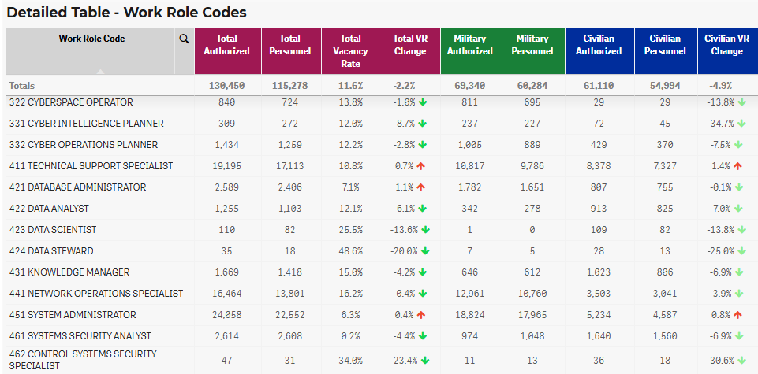

The Power of Work Role-Centric Data
Advana is the enterprise analytics platform for the DoD; ingests data from 10 Service Manpower/Personnel systems to support the cyber workforce effort.
Common Data Model generates 50+ unique KPIs to include Vacancy Rates, Turnover Rate and Time To Hire utilizing predictive analytic methods in near real time
ARMY
(FMS)
ARMY
Coding data
ARMY
(IPSS-A)
Authoritative Data Sources
Cyber
Work Role
AIR FORCE
(MPES)
AIR FORCE
Coding Data
AIR FORCE
(MILPDS)
NAVY
(TFMMS)
NAVY
Coding Data
NAVY
(NSIPS)
Common
Data Model
USMC
(TFSMS)
USMC
Coding Data
USMC
(MCTFS)
DoD
(FMTS)
DoD
4th Estate and Civilian Coding Data
DoD
(DCPDS)
Notes:
The following manpower (first) and personnel systems (last) are used for each Service:
4th Estate – FMTS and DCPDS
USAF – MPES, MILPDS and DCPDS
Army - FMS/AOD, IPPS-A and DCPDS
Marine Corps – TFSMS, MCTFS, DCPDS
Navy – TFMMS, NSIPS, DCPDS

Slide 14
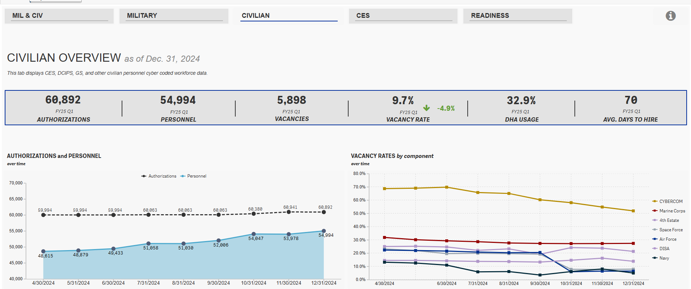
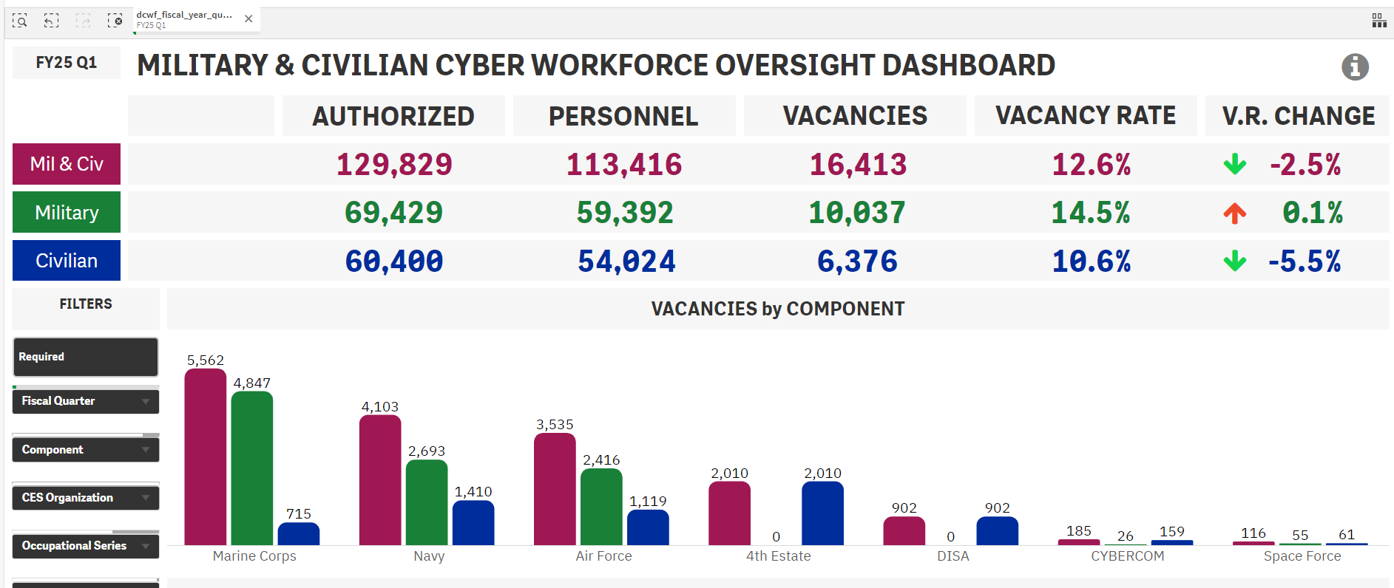
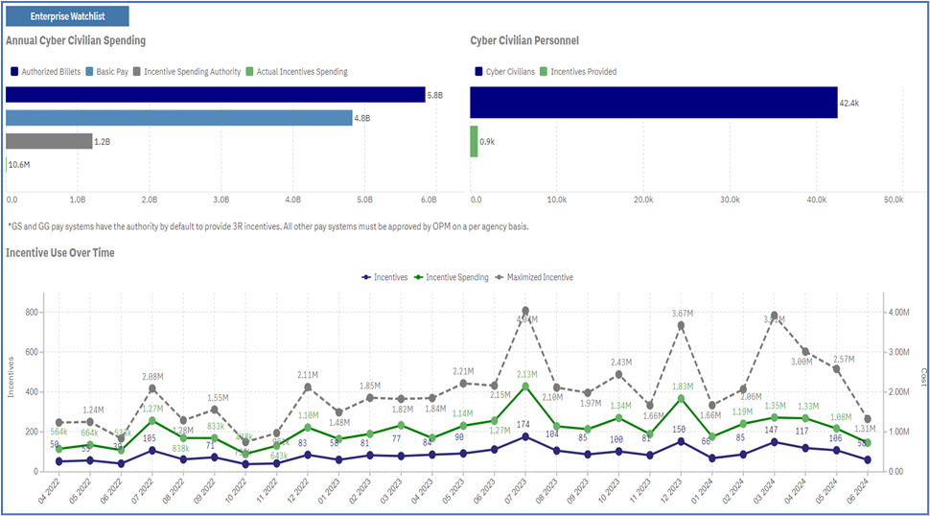
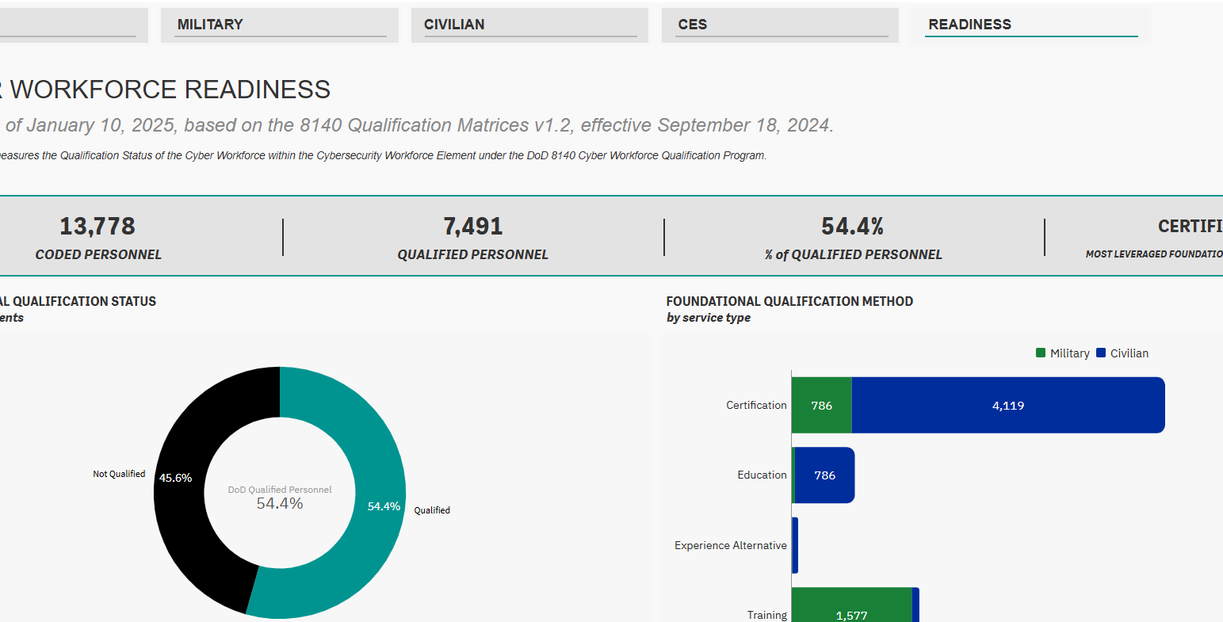
Workforce Tracking and Analytics - WDP
WDP provides enterprise-wide cyber workforce analytics that integrates with and informs accurate real-time decisions
Offers a spectrum of visualizations, from high-level executive dashboards to deep-dive analytic tools and specific views for targeted qualification.
Facilitates DoW senior leader decisions
EXECUTIVE OVERVIEW
Holistic view of the workforce at scale in support of informing executive leadership
WORKFORCE OVERSIGHT
Comprehensive views of cyber workforce & civilian performance
ADVANCED ANALYTICS
Detailed data points, queries for decision support
TARGETED QUALIFICATION
Coming soon – overview of DOD 8140 Qualification

Slide 15
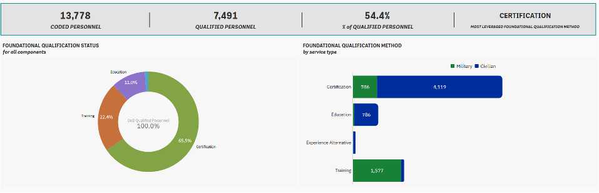
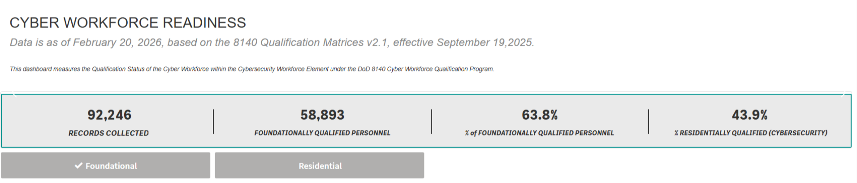
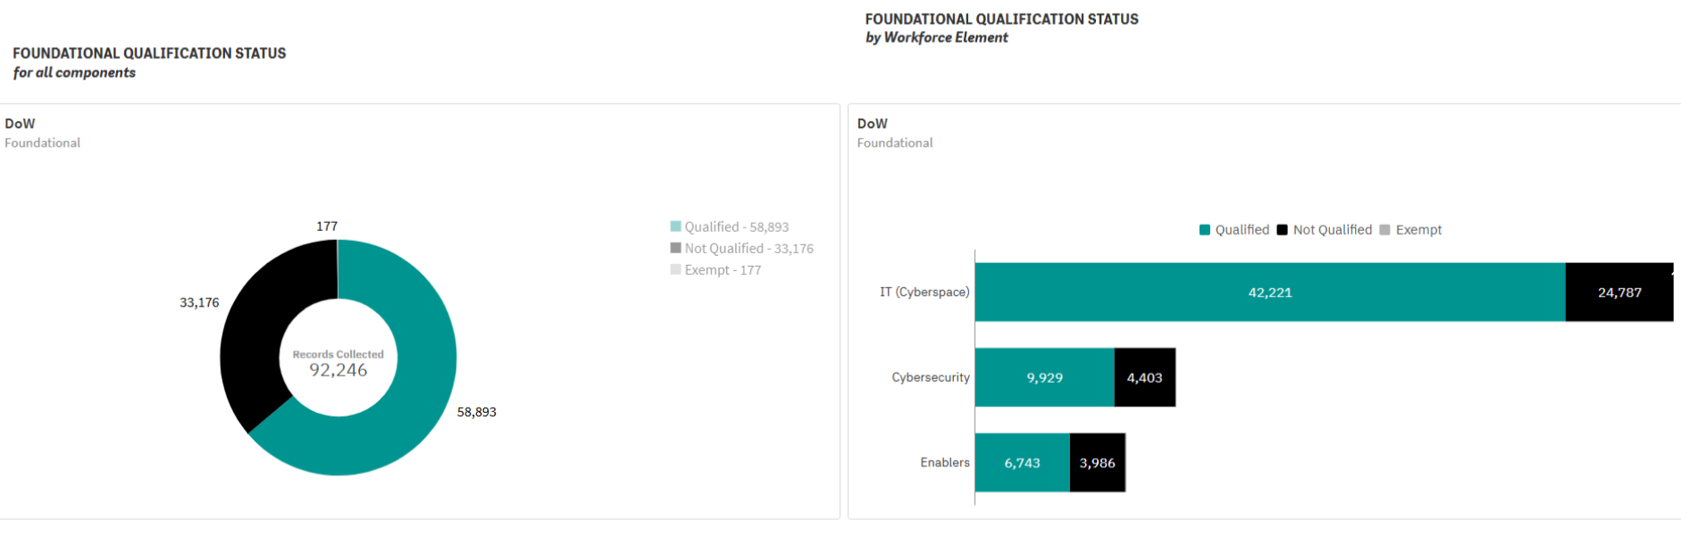
Next-Gen Readiness–
Powering the Cyber Force Through Analytics
FEB 2025:
Services began initial reporting on Cybersecurity element of DCWF
Appx 10% of the total DCWF population
Capabilities:
DoW/Service Foundational status
Includes how: (Education, Training or Certification)
FEB 2026:
Services reported on Cybersecurity, IT and Enablers Elements of DCWF
Approximately 70% of the total DCWF included in report scope reported: 92,000 of 133,000 personnel reported
Capabilities:
DoW/Service Foundational status
Demonstrates how: (Education, Training or Certification)
Includes Residential Qualification on Cybersecurity roles
Education
Experience Alternative
Certifications
Training
Education
Certifications
Experience Alternative
Training
Leveraging advanced analytics to shape a mission-ready cyber force at speed and scale

Slide 16

Next-Gen Readiness: Powering the Cyber Force Through Analytics
FEB 2026:
Services reported on Cybersecurity, IT and Enablers Elements of DCWF
Capabilities
DoW/Service Foundational status
Demonstrates how: (Education, Training or Certification)
Includes Residential Qualification on Cybersecurity roles
FEB 2027:
Services will report on Cybersecurity, IT, Enablers and Cyber Effects Elements of DCWF
Approximately 87% of the total DCWF included in report scope: 145,000 of 166,000 personnel
Capabilities
DoW/Service Foundational status
Demonstrates how: (Education, Training or Certification)
Includes Residential Qualification on Cybersecurity roles
Leveraging advanced analytics to shape a mission-ready cyber force at speed and scale

Slide 17
DoD 8140 Cyberspace Workforce Annual Reporting
Projected Timeline and Scope
 |  | 1 | 2 | 3 | 4 | 5 | 6
 |  | Oct 2024 - Jan 2025 | Summer 2025 | Oct 2025 - Feb 2026 | Oct 2026 - Jan 2027 | Oct 2027 - Jan 2028 | Oct 2028 - Jan 2029
CYBERSECURITY | Foundational | Included | Included | Included | Included | Included | Included
 | Residential |  |  | Included | Included | Included | Included
IT | Foundational |  |  | Included | Included | Included | Included
 | Residential |  |  |  | Included | Included | Included
ENABLERS | Foundational |  |  | Included | Included | Included | Included
 | Residential |  |  |  | Included | Included | Included
CYBER EFFECTS | Foundational |  |  | Excluded | Included | Included | Included
 | Residential |  |  |  |  | Included | Included
INTEL | Foundational |  |  | Excluded | Excluded | TBD | TBD
 | Residential
DATA/AI | Foundational |  |  | Excluded | Excluded | Included | Included
 | Residential |  |  |  |  |  | Included
SOFTWARE ENG. | Foundational |  |  | Excluded | Excluded | Included | Included
 | Residential |  |  |  |  |  | Included
 | Suspense |  | 1-`Aug-25 | 20-Feb-26 | 15-Jan-27 – tent. | Jan-28 -tent. | Jan-29- tent.
 | NOTES | 462 work role excluded | 462 work role excluded | 462 work role included
 | SCOPE | Military and Civilians | Military and Civilians | Military, Civilians, Guard and Reserve | Military, Civilians, Guard and Reserve | Military, Civilians, Guard and Reserve | Military, Civilians, Guard and Reserve
*Inclusion of DoW Contractors Coming Soon

Slide 18





Future DCWF Applications
180K
Military and Civilian Cyber Workforce
Ingestion of Service authoritative manpower/personnel systems
Enterprise aggregation & visualization
Holistic coding of IT, Cybersecurity, Cyber Intel, Cyber Effects and Enablers
Initial Cyber Workforce Qualification Reporting
Finalize Data/AI & Software Engineering work role coding
Expand DCWF to include Spectrum/EW
Code contractors
Industry benchmarking
Total Force Analytics
Workforce Readiness Expansion
Data-driven Training Support Decisions
Qualified Workforce to Defeat the Adversary
Percentage Qualified
Foundational & Mission Readiness Qualification
WHY IT
MATTERS
MEASURING
PROGRESS

Slide 19



Cyber Workforce Management Board (CWMB)
  Recent (2026) Decisions:
    Added three work roles to receive incentive pay to help recruitment and retention through the Cyber Excepted Service (CES) Targeted Local Market Supplement (TLMS) program.
    (632) Systems Developer
    (661) Research and Development Specialist
    (752) Cyber Policy and Strategy Planner
    Added three new work roles to the DoD Cyber Workforce Framework (DCWF)
    Secure Configuration Specialist, Cyber IT element
    System Security Engineer, Cybersecurity element
    Information Systems Security Officer (ISSO), Cybersecurity element
    Directed a core universal knowledge statement regarding Zero Trust be added to all DCWF work roles.
  Purpose:
    A SES/GO/FO level decision body that provides guidance to the implementation authorities regarding cyber workforce standards, requirements, personnel systems, qualifications, training, and compliance.
    The Tri-Chairs (DoW Chief Information Officer, Under Secretary of War for Personnel and Readiness, and the Assistant Secretary of War for Cyber Policy / Principal Cyber Advisor) vote and make key decisions on cyber workforce matters in this forum in collaboration with the Standing Members.
  Cadence:
    Meetings are conducted quarterly
    Next CWMB: 17 Sep 2026 (tentative);
    contingent on Tri-Chair availability and scheduling
    Core Agenda
      DCWF Health & Readiness
      8140 Work Roles
      TLMS Checkpoint

Slide 20
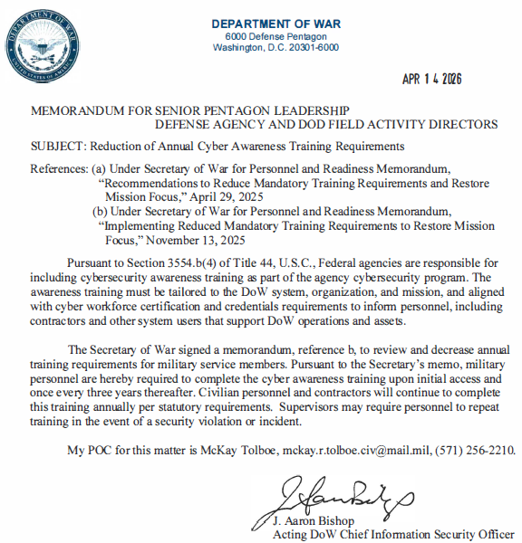
Cyber Workforce Advisory Group (CWAG)
CWAG Purpose & Membership
Purpose: Coordinate cross-departmental efforts and provide foundational analytic support to the Cyber Workforce Management Board (CWMB).
Membership: Action Officer (AO) level.
Periodicity: Ad hoc (based on mission requirements).
Future Meetings
August 2026: Solicit proposed content changes to Cyber Awareness Challenge (CAC)
September 2026: Vote on final CAC content changes
Co-Facilitators: DoW CIO CS and DISA
Policy Update
Reduction of Annual Cyber Awareness Training Requirements (Effective 14 Apr 2026):
Military Personnel:
Every 3 years (after initial training)
Civilians & Contractors:
Annually (No change)

Slide 21

DoD 8140 Administrative Update
Contractor Requirements
DFARS OPEN CASE #2023-D021
CANCELED
CLASS DEVIATION
DFARS PART 239 IN EFFECT

Slide 22
DoW CWF Summit 2.0
CWF Summit 2026 Continuous Professional Development
Approvals for CompTIA CEUs, GIAC CPEs, and/or CertNexus CECs are for 1 unit per full hour of session content. Help meet the session time requirement by asking questions. Please check with your supervisor to confirm which sessions meet your training requirements.
As of 4/20/26; sessions are currently under review and approvals may be added post-session.
Session Date | Session Start Time (1 hour unless noted) | Session Title | Room Number | For the purposes of this brief, each session has been given a code (A, B, C). Please align the session letter with the corresponding certification.
3/24/26 | 1:45 PM 3:00 PM | Combined Session: Keynote: Setting the Rules of the Road – Policy for Strategic Competition and Panel: Operationalizing Academia | Lincoln Hall Auditorium | Session A
3/25/26 | 11:00 AM | Panel: Implementation of DoD 8140 – Deploying an Agile, Capable, and Ready Cyber Workforce | Lincoln Hall Auditorium | Session B
3/25/26 | 9:45 AM 1:30 PM | Combined Session – CCMD Perspective: The Mission-Critical Cyber Operator and Keynote: Strategic Overmatch: Forging the Arsenal of Talent for Cyber Warfare | Lincoln Hall Auditorium | Session C

Slide 23
DoW CWF Summit 2.0
CWF Summit 2026 Continuous Professional Development
Approvals for CompTIA CEUs, GIAC CPEs, and/or CertNexus CECs are for 1 unit per full hour of session content. Help meet the session time requirement by asking questions. Please check with your supervisor to confirm which sessions meet your training requirements.
As of 4/20/26; sessions are currently under review and approvals may be added post-session.
Session Code | Industry Certification
Session A | Certnexus: CFR ; CAIP ; CEET ; CDSP GIAC
Session B | Certnexus: CFR ; CAIP ; CEET ; CDSP GIAC CompTIA: A+ ; DataSys+ ; Network+ ; Server+ ; Security+ ; Linux+ ; Cloud+
Session C | Certnexus: CFR ; CAIP ; CEET ; CDSP GIAC CompTIA: A+ ; DataSys+ ; Network+ ; Server+ ; Security+ ; Linux+ ; Cloud+

Slide 24


DoD 8140 Seminar Announcement
FORGING A QUALIFIED FORCE TO WIN IN CYBERSPACE
Power your mission-driven cyber workforce by mastering the DCWF and DoD 8140 tailored qualification
pathways to gain decision advantage for future reporting requirements.
Discover how the DCWF is evolving
Understand current DoD 8140 foundational qualification standards
Experience a live DoD 8140 qualification exercise
Prepare for the next DoD 8140 annual report
Tuesday, September 22, 2026 • 1000-1200 Eastern Time • Virtual via MS Teams
DoW CIO Point of Contact: cameron.r.myette.ctr@mail.mil
24

Slide 25

DOW COMPONENT OPEN FORUM

